Slide 1
Enlisted Assignment System
Notes:
Time Required: 80 min

Slide 2
Enabling Objectives
LIST purposes of the Enlisted Assignment System
DISCUSS the types of duty in the Enlisted Assignment System
DEFINE Projected Rotation Date (PRD), Time-On-Station (TOS) and Obligated Service (OBLISERV)
DESCRIBE the differences between Detailers (BUPERS 40X) and Placement (BUPERS-4013)
DISCUSS how assignment incentives contribute to the Enlisted Assignment System
DISCUSS Billet Based Advancement and its impact on Sailors
DESCRIBE the process to match Service Member’s needs with their duty preferences
LIST the process to complete an Electronic Personnel Action Request (ePAR 1306/7)
Notes:
FACILITATORS GUIDE:
Review objectives.

Slide 3
References
NAVPERS 15560: Navy Military Personnel Manual,
MILPERSMAN 1306-141: Voluntary Sea Duty Program
MILPERSMAN 1300-1000: Military Couple and Single Parent Assignment Policy
MILPERSMAN 1300-500: Reassignment for Humanitarian Reasons
MILPERMAN 1306-106: Time on Station (TOS) and Retainability Obligated Service (OBLISERV)
MILPERSMAN 1306-104: Projected Rotation Date (PRD)
MILPERSMAN 1306-700: Exchanges of Duty (SWAPS)
Notes:
FACILITATOR GUIDE:
Review references.

Slide 4
References
NAVADMIN 112/25: Billet Based Advancements 2025
NAVADMIN 172/22: Active Duty Enlisted Advance-to-Position Program Update
Billet Based Advancement Handbook
MyNavy Assignment:
MNA-CMD/CCC Interactive Guide
NAVADMIN 276/19
Assignment Incentive Pay (AIP) Program: CNO Policy Decision Memo 003-06
Sea Duty Incentive Pay (SDIP): POLICY DECISION MEMORANDUM (PDM) 001-21
Notes:
FACILITATOR GUIDE:
Review references.
Removing DMAP NAVADMINs due to no longer being relevant and BBA NAVADMIN being updated information.
Addition of NAVADMIN 255/24, Billet Based Advancements 2025 and the Billet Based Advancement Handbook.

Slide 5
Enlisted Assignment System Purpose
System for distribution of enlisted personnel
Places the right person in the right job with the right skills at the right time
Ensure proper fit and fill for each billet
Promotes maximum readiness afloat and ashore
Permits equal opportunity for personnel to serve in duty they consider desirable
Prevent gaps on sea and shore
Notes:
FACILITATOR GUIDE:
Discuss how the Navy’s manning affects advancement and readiness
Enlisted Community Managers (ECMs) are required to keep specific percentages their rate at shore and at sea to ensure the proper manning of commands.
Discuss that MNA is designed to provide the Navy with the right person in the billets.
Detailers can match individuals with jobs based on what is in their records/Commands are able to make comments on applications regarding who they want for a billet (this is why we will talk later about updating your Resume in MNA!)/Sailors who are selected for billets they want or are interested in tend to work harder and be more productive in their work environment.

Slide 6
Enlisted Assignment System Common Terms Definitions
Projected Rotation Date (PRD) – established when orders are written
MPM 1306-104
Time-On- Station (TOS) – period served in same geographical area
Period served in same geographical area
MPM 1306-106
Obligated Service Requirements (OBLISERV) – minimum amount of active service Sailors must agree to before executing a PCS transfer
MPM 1306-106/NAVADMIN 307/17
DoD Tours – Tours must meet Department of Defense (DoD) overseas tour lengths. Service members may be reassigned up to 60 days prior to completion of the full tour length and be considered as having completed the full tour
Notes:
FACILITATOR GUIDE:
Example of common terms used during the assignment process.
PRD- Your PRD is dependent on your rate and how long your sea/shore flow is prescribed for. For many rates the rotation is 4-5 years sea duty followed by 3 years shore duty. (see https://www.mynavyhr.navy.mil/Portals/55/Career/ECM/Sea%20Shore%20Flow%20Tour%20Lengths.pdf?ver=M3-xUNwFWEbNJWFI_kYRZA%3d%3d for sea shore flow)
Example; AEAN Bean checks in on April 14th, 2025 to their first sea duty command. They will have a PRD of Nov 2029 due to AEs having a 4.5-year initial sea rotation. When AE2 Bean goes to transfer to their shore duty tour, reporting in May 2030, they will have a PRD of May 2033, 3 year shore tour.
**Detailers may direct transfer up to 6 months prior to PRD and up to 6 months after PRD for flexibility**
TOS- Time on station requirements are established to enhance operational readiness by stabilizing Service members in units in order to help reduce PCS costs and improve the quality of life by reducing personal or family turbulence. MINIMUM TOS REQUIREMENTS: To CONUS Shore duty - 24 months/to CONUS Sea duty – 12 months. The minimum TOS requirements are in place for those members who REFUSE to OBLISERV for a full tour and intend to separate.
OBLISERV- OBLISERV is written into member’s orders. This is the timeframe that the member must either reenlist or extend to meet. OBLISERV is determined by the member’s rate and the sea/shore flow, UNLESS member is accepted for a special program with its own OBLISERV requirement.
DoD Tours- DoD area tour lengths are listed in reference NAVSO P-6034, Joint Travel Regulations (JTR), appendix Q.

Slide 7
Enlisted Assignment System Manning Control
Consists of two functions:
Manning:
The function of determining the quality, quantity, and priority for assignment of personnel to all billets within a unit
Enlisted Community Managers (ECM) – Typically, NCs will contact directly for the member
Placement:
Serves as the “gatekeeper” to ensure that policy is being followed. “Command’s advocate”
Detailers – Can be contacted by the command, CCC, or the Sailor. They are the “Sailor’s advocate”
Notes:
FACILITATOR GUIDE:
Manning
Function: Quality of Alignments evaluation
Keep your CCC advised of unplanned losses (pregnancy/HUMS/early transfers/separations).
MNA User’s Guide V3.0i (Ch. 18)
As Sailors advance or unplanned losses come about ensure routine review to submit MRR for realignment.
Placement: Commands advocate to assist in maintaining a balanced crew prior to deployment.
Function: Alignment changes
The CCC and AMM should keep Placement Coordinators in the loop when processing unplanned loses.

Slide 8
Enlisted Assignment System Detailer
What Detailers CAN do
Counsel and advise Sailors as their advocate
Make assignments to valid billets
Adjust PRD with NAVPERS 1306/7
Transfer Sailors up to +6/-6 months of PRD
Coordinate spousal collocations
Make assignments for Sailors for Pregnancy and LIMDU.
Issue “non-voluntary” orders
When Sailors contact the detailer, it is recommended to keep their CCC and CoC in the loop for clarity and added support
Notes:
FACILITATOR GUIDE:
Encourage CDT to always attempt to call or email the detailer regarding questions about orders. To ensure you are aware a “best practice” is to have them copy you on all inquires for your awareness.
Sailors should always be encouraged to communicate EARLY and often with their detailer about their desires and any situations that could have an impact on orders selection.

Slide 9
Enlisted Assignment System MyNavy Assignment (MNA)
Detailers attempt to match Sailor’s needs through MyNavy Assignment preferences:
Preferences should be submitted mid-tour or no later than 16 months prior to PRD
Order negotiation window starts 12/11 months prior to PRD
If interested in Special Programs, recommend CDB with CoC and CCC, and ensure discussion of Special programs with detailer PRIOR to entering negotiations window
Refer to the applicable MPM article to determine when to apply for special duty
Notes:
FACILITATOR GUIDE:
Sailors must ensure their MNA contact information is up to date. This will prevent detailers from having issues with contacting the Sailor regarding orders and career intentions.
Ensure that your Resume and Preferences are updated before entering your negotiation window, this information assists the detailer AND the gaining commands review and rank all applicants to each billet. Include COMPLETED items like important qualifications, collateral duties, warfare qualifications, and awards earned while at that command.
In MyNavy Assignment you can:
Explore new opportunities for personal growth, promotion and rewarding service.
Showcase personal skills and market yourself to future commands.
Apply for jobs, interact with detailers and track Permanent Change of Station (PCS) orders.
MNA increases your visibility to all generated jobs (vacancies) in the detailing cycle, both jobs that are open for application and closed (not available for application due to mission requirements).

Slide 10
Enlisted Assignment System MyNavy Assignment (MNA)
What is MNA?
Modern interface to the Detailing Marketplace
Key Benefits & Features
Anytime access to job search and resume tools
Expanded Job Visibility: View open & closed billets
Bookmark Up to 100 Jobs
More Applications: 7 per cycle (two-week window)
Application Tracker Dashboard
Advanced Search Tools: By Qualification, Rate, Preferences
New Capabilities
My Resume: Highlight skills for detailers/commands
PACT Sailor Integration: Auto-Qualify for rate designation upon selection
Enhanced Messaging: CCC tools & notifications on homepage
Direct CCC Support: CCCs can assist/apply on Sailor's behalf
Notes:
FACILITATOR GUIDE:
Sailors must ensure their MNA contact information is up to date. This will prevent detailers from having issues with contacting the Sailor regarding orders and career intentions.
In MyNavy Assignment you can:
Explore new opportunities for personal growth, promotion and rewarding service.
Showcase personal skills and market yourself to future commands.
Apply for jobs, interact with detailers and track Permanent Change of Station (PCS) orders.
MNA increases your visibility to all generated jobs (vacancies) in the detailing cycle, both jobs that are open for application and closed (not available for application due to mission requirements).

Slide 11
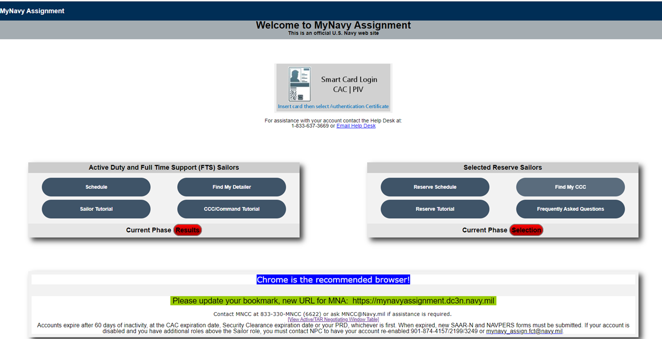
Enlisted Assignment System MyNavy Assignment (MNA)
Select to LOG ON
Displays MNA schedule for Phases
Displays CURRENT PHASE
Access​
How to Access: https://my.navy.mil/ → MyNavy Assignment link​
Support: MNCC: 1-833-330-6622 | Email: ASKMNCC@navy.mil
Notes:
FACILITATOR GUIDE:
Discuss location of “View Access/TAR Negotiation window Table" - Table is on following slide. Application cycle begins the end of EVEN months (Feb, Apr, Jun, etc) and is open typically for 10-12 days.
Discuss location of Schedule - Use button located on left for Active duty/TAR schedule. Schedule breaks down each month by PHASE of cycle. It is color coded, GREEN is the application phase.
Discuss “Phase” cycles – There are 7 phases that Sailors should be aware of: TYCOM requisition, Integrated Readiness Requisition review, NPC Requisition scrub, Available for Applications, Command Comments, Detailer selection, and Application Results. (Maintenance/Alignment/REQ load are also listed on the schedule)
Discuss and encourage Sailor Tutorial to aid in their navigation – Sailors should pay special attention to the "My Info" section of the tutorial! This will walk them through how to update personal information, Preferences, and their Resume.
Discuss and encourage CCC/Command Tutorial for your CDT – Should be reviewed by all members of the CDT in order to assist Sailors with questions about MNA.

Slide 12
Enlisted Assignment System MyNavy Assignment (MNA) Negiation Window Schedule
Sailor’s Projected Rotation Date | First MNA Negotiation Window | Second MNA Negotiation Window | Third MNA Negotiation Window
January | February - March | April - May | June - July
February | February - March | April - May | June - July
March | April - May | June - July | August - September
April | April - May | June - July | August - September
May | June - July | August - September | October - November
June | June - July | August - September | October - November
July | August - September | October - November | December - January
August | August - September | October - November | December - January
September | October - November | December - January | February - March
October | October - November | December - January | February - March
November | December - January | February - March | April - May
December | December - January | February - March | April - May
"Note: Sailors may be selected for orders in their first or second cycle. Sailors with PRDs of six months or less will not be able to submit applications via MNA. In those cases, Sailors should contact their Rating Detailer."
Notes:
FACILITATOR GUIDE:
Discuss purpose of PRD/SEAOS impact in relation to submission timelines IAW their negotiation window.

Slide 13
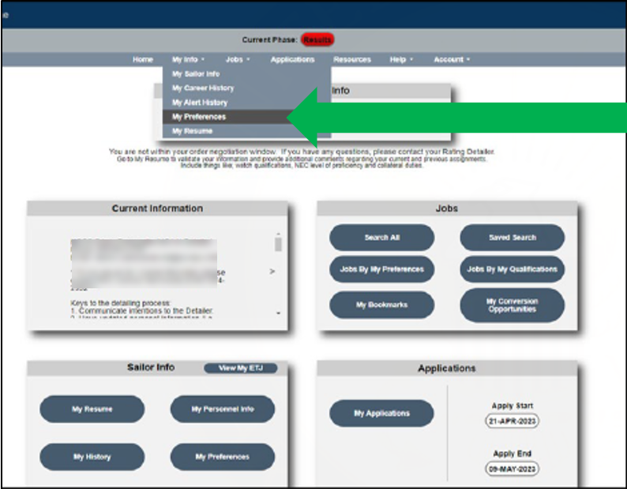
Enlisted Assignment System MyNavy Assignment (MNA) Preferences
Select to update your preferences
Preferences give additional Information to your detailer while working the process, giving the Sailor the opportunity to communicate their priorities and desires to the detailer
Notes:
FACILITATOR GUIDE:
Recommend users complete My Preferences prior to entering negotiation window.
Discuss keeping “My Preferences” up to date at all times.
Discuss keeping “My Sailor Info” up to date at all times. Detailers can reach out to notify of new incentives and potential orders.

Slide 14
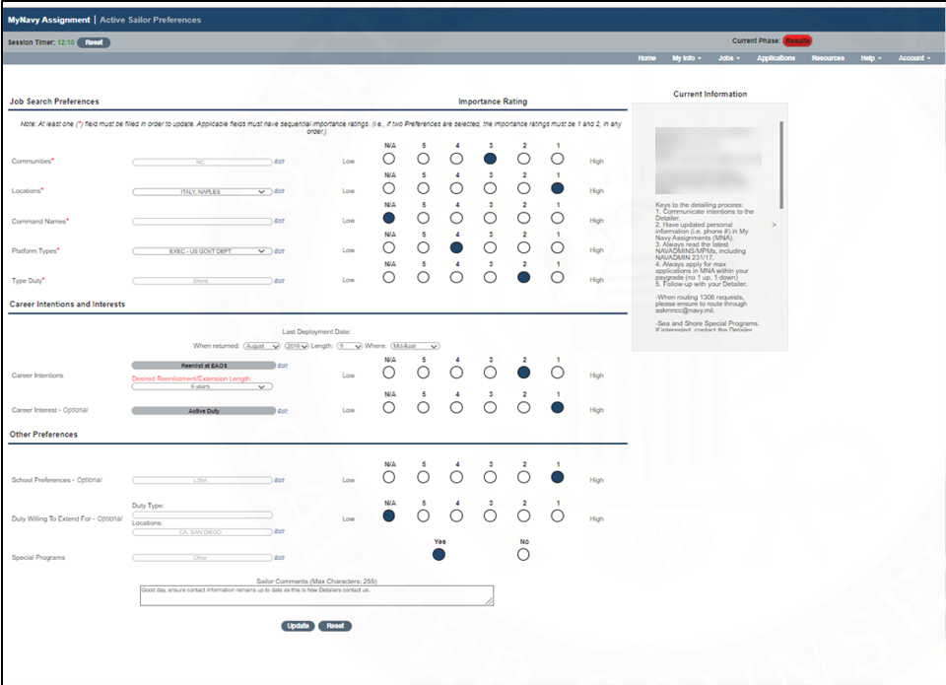
Enlisted Assignment System MyNavy Assignment (MNA) Preferences
Keys to the detailing process: 1. Communicate intentions to the Detailer 2. Have updated personal information (i.e. phone #) in My Navy Assignments (MNA) 3. Always read the latest NAVADMINS/MPMs, including NAVADMIN 231/17 4. Always apply for max applications in MNA within your paygrade (no 1 up, 1 down) 5. Follow-up with your Detailer
Notes:
FACILITATOR GUIDE:
Discuss numerical sections must be sequential. (ex: 1, 2, 3, 4 not 1, 3, 4, 2, 5)

Slide 15
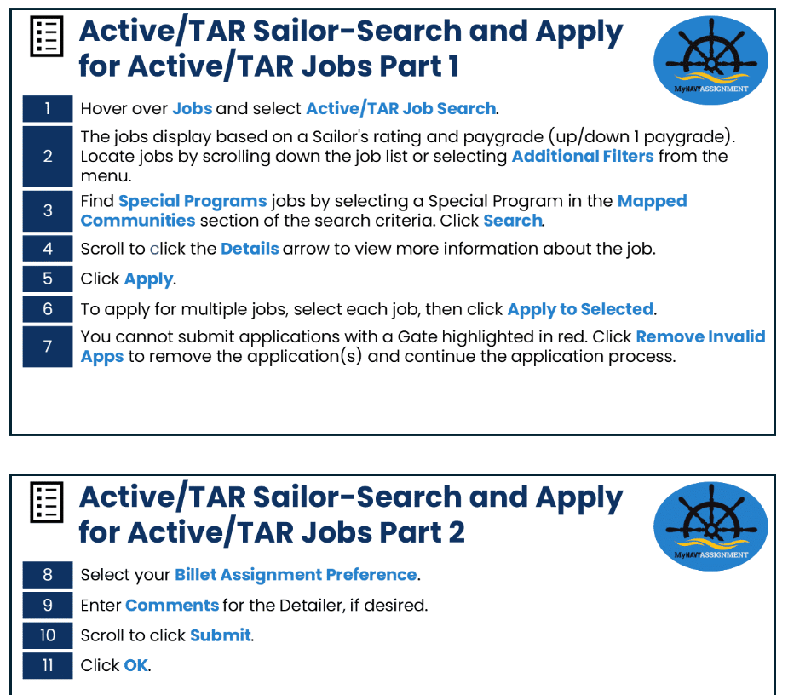
Enlisted Assignment System MyNavy Assignment (MNA) Applying for Orders
Notes:
*Have Sailors review the Sailor Tutorial on the MNA login page for details on applications!
FACILITATOR GUIDE:
Submit Applications: Displays when you are within your order detailing negotiation window and authorized to submit up to seven applications.
Applied: Displays the number of applications you have submitted up to seven.
Selected: Displays when you have been selected for a job.
Orders Under Review: Displays when you have been selected for a job and your orders are being processed.
Orders Pending Release: Your orders are waiting final release.
Orders Negotiation Window Closed: Displays “The order negotiation window has closed for this cycle” when MNA will no longer accept applications for that cycle.
Blank/Expired Projection Rotation Date: Displays “Your projected rotation date (PRD) is blank or expired. Please contact your Rating Detailer” when your PRD is blank or expired.

Slide 16
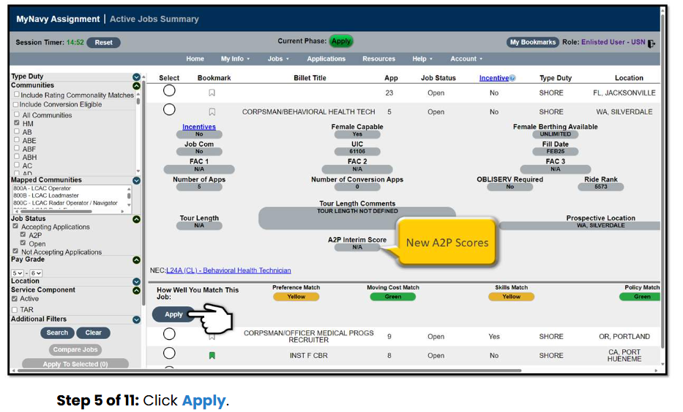
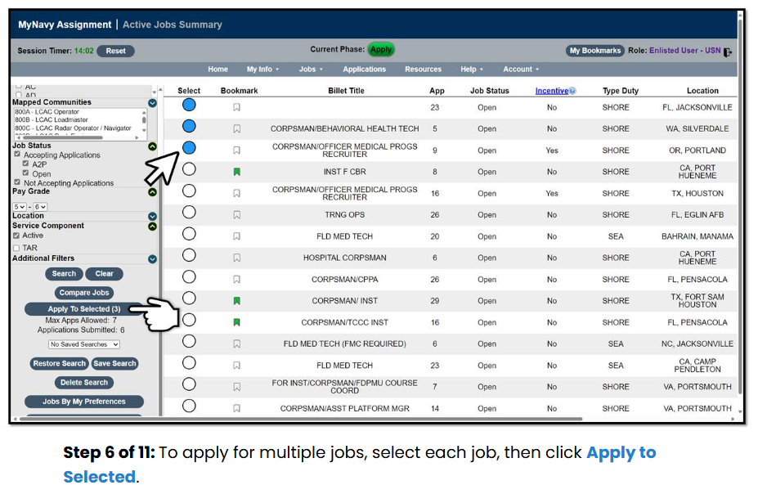
Enlisted Assignment System MyNavy Assignment (MNA) Applying for Orders
Notes:
*Have Sailors review the Sailor Tutorial on the MNA login page for details on applications!
FACILITATOR GUIDE:
Submit Applications: Displays when you are within your order detailing negotiation window and authorized to submit up to seven applications.
Applied: Displays the number of applications you have submitted up to seven.
Selected: Displays when you have been selected for a job.
Orders Under Review: Displays when you have been selected for a job and your orders are being processed.
Orders Pending Release: Your orders are waiting final release.
Orders Negotiation Window Closed: Displays “The order negotiation window has closed for this cycle” when MNA will no longer accept applications for that cycle.
Blank/Expired Projection Rotation Date: Displays “Your projected rotation date (PRD) is blank or expired. Please contact your Rating Detailer” when your PRD is blank or expired.

Slide 17
Enlisted Assignment System Billet Based Advancement (BBA)
BBA expands Active-Duty Sailors choice and reduces the number of E-5 and above vacancies across the Fleet
BBA serves to link enlisted advancements directly to billets through the following programs:
Transitioned from Navy Wide Advancement Exam (NWAE) to Rating Knowledge Exam (RKE)
Advancement to Position (A2P)
Command Advancement to Position (CA2P)
Sea Duty
Shore Duty
Senior Enlisted Marketplace (SEM)
Advance Request Alignment (ARA)
Notes:
FACILITATOR GUIDE:
NWAEs for advancement to E-5 and E-6 for the BBA ratings will transition to Rating Knowledge Exams (RKEs) to attain CA2P and A2P eligibility. Professional Military Knowledge PMKEE and Enlisted Leader Development LDC courses are eligibility requirements to take RKEs as well as specific rating requirements.

Slide 18
Enlisted Assignment System Billet Based Advancement (BBA)
BBA paths of Advancement for E5 and E6 include:
Advancement to Position
Upon successful completion of RKE, Sailors may apply for orders in MNA for the next higher paygrade regardless of PRD
May be frocked upon receipt of orders, after completion of applicable screening
Advanced after checking into ultimate duty station
Command Advancement to Position (CA2P) for Sea Duty
Allows commands to move Sailors into open billets onboard
ISIC can move eligible Sailors to an open billet at an activity (geographic area)
No prospective gain or tentative gain identified
Must have at least 18 months tour completion and fill a 36-month OBLISERV
Not available for Sailors with orders, orders pending release, or within negotiation window
CA2P for Shore Duty
All CA2P for Sea Duty requirements apply
Incur 36 month OBLISERV, allowing for a follow-on 36-month tour
PRD at Sailor’s current command will not be extended
Notes:
CA2P:
Command Advance to Position. Applicants must:
PNA last NWAE
Have 24 months cumulative seat time
Be on type 2,3,4 duty.
Submit requests to MRR or Email to PERS-4013
Required additional 36 months past the date the CA2P was approved or members PRD which ever is later.
Further Guidance:
Guidance is found on MyNavy HR on the CA2P letter that needs to be submitted to the command after approval.
NAVADMIN 111/24 for further guidance.

Slide 19
Enlisted Assignment System Rating Knowledge Exam (RKE)
NWAE replaced by Rating Knowledge Exam (RKE) for BBA ratings starting March 2025 (Cycle 267)
Who It Affects
Active Duty Sailors in BBA Ratings: ABE, ABF, ABH, AME, AO, CS, DC, EM, IC, GM, GSM, MM, QM, RS
E5 and E6 paygrades
What’s Different with the RKE
Same format and scope as NWAE
No Time-in-Rate (TIR) requirement for E4/E5
Retake required only once every two years
Administered like NWAE but advancement through A2P & CA2P
Important Dates – Outlined in Advancement NAVADMIN(s)
PMK-EE Deadline
E6 RKE Date
E5 RKE Date
Notes:
FACILITATOR GUIDE:
RKEs are required to only be taken one time per paygrade BUT Sailors can retake them each cycle if they want to better their Final Multiple Score (FMS). Sailors who pass the RKE and have a Commanding Officer/Officer in Charge's recommendation for advancement will have a Detailing Marketplace Eligibility Indicator (DMEI) applied to their MNA record, which will allow Sailors to apply for jobs in the next-higher paygrade, regardless of Projected Rotation Date (PRD).

Slide 20
Enlisted Assignment System Senior Enlisted Marketplace (SEM)
Senior Enlisted Marketplace
Board-Screened E-7 and E-8 Sailors
Starting FY26 CPO Board - E-6 to E-7 SEM Integration
E-6 Sailors will take the NWAE
Screened Sailors will have a DMEI applied to their MNA record regardless of PRD, ACC or order status
Negotiate for orders through MNA advertised SEM billets
ELD for E7/E8, Senior Enlisted Academy for E9
Key Features
24 Months to be selected for a job in the next higher pay grade
SEM guidance for E-7 advancements
Notes:
FACILITATOR GUIDE:

Slide 21
Enlisted Assignment System Senior Enlisted Marketplace (SEM)
Sailors screened for advancement must
Negotiate orders within MNA
Obligate as directed by orders, normally 36 months
Pass all applicable screenings
Complete required billet training en-route
Minimum 12 months onboard current command
Frocking for E-8/E-9 Sailor’s once OBLISERV is complete with hard copy orders
SEM A2P advancements are effective on the date the Sailor checks onboard their ultimate duty station
Notes:
FACILITATOR GUIDE:

Slide 22
Enlisted Assignment System Senior Enlisted Marketplace (SEM)
SEM A2P
Allows Sailors to apply for jobs in the next higher paygrade regardless of PRD, upon being screened for advancement from a fiscal year screening board
Sailors are eligible to apply for jobs for 24 months after screening
Frocked Chiefs who have not selected orders within 24 months will be direct detailed
E8/E9 Sailors may be frocked when they receive orders, after completing screening requirements, and fulfilling obligated service for those orders
SEM A2P advancements are effective on the date the Sailor checks onboard their ultimate duty station
Notes:
FACILITATOR GUIDE:

Slide 23
Enlisted Assignment System Senior Enlisted Marketplace (SEM)
SEM Advancement Request Alignment (ARA):
Allows commands the ability to advance a screened Sailor on station when there is a valid, funded and vacant billet at the next higher paygrade
For E8/E9 Sailors, the ARA window will open immediately after the current Fiscal Year results release and will close at the conclusion of Naval Personnel Command’s (NPC) requisition scrub phase in My Navy Assignment, which takes place in August
For E7 Sailors, ARA will open on September 16 and will close at the conclusion of NPC’s requisition scrub phase in My Navy Assignment, which takes place in October
General duty billets must meet the higher vacant paygrade requirement and will be restricted to the source rating requirement
Billet must not have a tentative gain or prospective gain identified
ARA for sea duty: Sailor must incur obligated service and extend PRD for 36 months from the date of advancement
ARA for shore duty: Sailor must incur 36 months obligated service for follow-on tour; PRD will not be extended
Notes:
FACILITATOR GUIDE:

Slide 24
Enlisted Assignment System Senior Enlisted Marketplace (SEM) Scoring Criteria
Distribution Guidance Memorandum (DGM) #40104-2408 dtd 19 August 2024:
Scoring Element | Weight Multiplier
Rating | 10
Command Ranking | 10
Paygrade/Merit | 25
NEC | 15
Application Ranking | 20
Cumulative Sea Time | 20
Tie Breaker is Time in Grade and then Time in Service
Notes:
FACILITATOR GUIDE:
Sailors screened for advancement must:
Negotiate orders within MNA/SEM
Obligate 36 Months for orders if selected
Pass all applicable screenings
Complete required billet training en-route
Minimum 12 months onboard current command
Frocking for E-8/E-9 Sailor’s once OBLISERV is complete with hard copy orders
Sailors will be advanced upon execution of orders
SEM Sailor scoring criteria https://www.mynavyhr.navy.mil/Career-Management/Detailing/Enlisted/Senior-Enlisted-Marketplace/
Exemptions:
TAR and SELRES ratings
Command Senior Enlisted Leader Programs
Submarine
Nuclear
Musician (E-7 Only)
SEAL
Special Boat Operator

Slide 25
Enlisted Assignment System Command Advance to Position (CA2P)
Commands/TYCOMs can submit request through MRR or Email the commands Placement Coordinator (PERS-4013)
CO-recommended E-4/E-5 Sailors
Not within 12 months of PRD
Serving in Type 2, 3, & 4 Sea Duty or PCU
Billet in higher pay grade must be available or will become vacant
24 Months Cumulative Sea Time (E-4) for eligibility
18 Months of Tour Completion as an E-5 for eligibility
Sailor must obligate an additional 36 months at command (PRD adjustment)
Advanced once member is approved in MNA
OPNAV N132 will accept ETPs for extenuating circumstances
Notes:
CA2P:
Applicants must:
PNA last NWAE
Be on type 2,3,4 duty.
Submit requests to MRR or Email to PERS-4013
Required additional 36 months past the date the CA2P was approved or members PRD which ever is later.
Shore Command Advance to Position (CA2P):
CO-recommended E-4/E-5 Sailors
Not with in 12 months of PRD
Billet in higher pay grade must be a valid, unencumbered billet which is both aligned to Sailor’s rating/NEC
Obligated Service 36 Months beyond advancement date, PRD will not be extended.
Further Guidance:
Guidance is found on MyNavy HR on the CA2P letter that needs to be submitted to the command after approval.
NAVADMIN 111/24 for further guidance.

Slide 26
Enlisted Assignment System Advance to Position (A2P)
DGM 4092-2508 dtd 15 August 2025:
Advance to Position (A2P):
Advertised in MNA
Apply for up to 7 positions per cycle
Selection is based on Sailor Scoring Criteria (SSC)
Always verify on MyNavy HR for the current SSC
Scoring Element | Weight Multiplier
Rating | 10
Pay Grade | 20
NEC | 15
Sailor App Ranking | 20
Command Ranking | 5
FMS | 20
Sea Credit | 10
Tie Breaker is Time in Grade and then Time in Service
Sailor Scoring Criteria
Notes:
FACILITATOR GUIDE:
Sailor Scoring Criteria for Journey man and Supervisors https://www.mynavyhr.navy.mil/Career-Management/Detailing/Enlisted/Detailing-Marketplace/

Slide 27
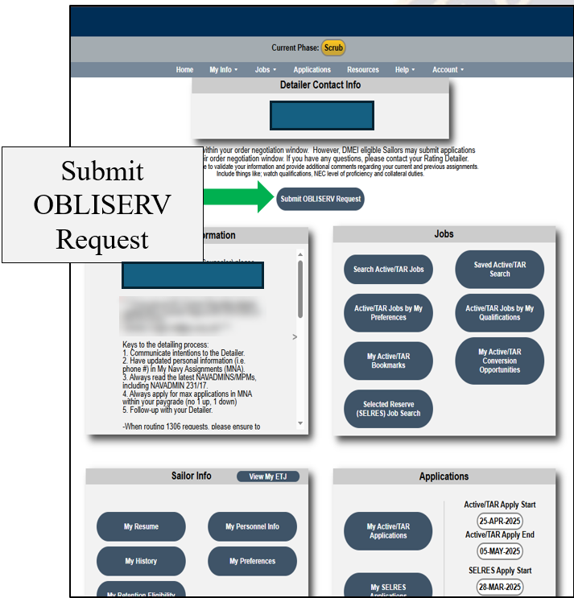
Enlisted Assignment System MNA OBLISERV Request
OBLISERV request are submitted in MNA
Member can request to OBLISERV by clicking on “Submit OBLISERV Request”
Command Career Counselors with Enlisted CCC MNA access can also submit OBLISERV request on behalf of Sailors
Note: Personnel must be “Qualified” in Career Waypoints to OBLISERV
Notes:
FACILITATOR GUIDE:
Note: Personnel must be “Qualified” in Career Waypoints to OBLISERV.
Members can request OBLISERV themselves via MNA (see slide), or the CCC can request the OBLISERV for the Sailor in the CCC access of MNA. C-WAY is still utilized for those Sailors wishing to affiliate with the SELRES as well as for "qualifying" all Sailors within the C-WAY system for processing.

Slide 28
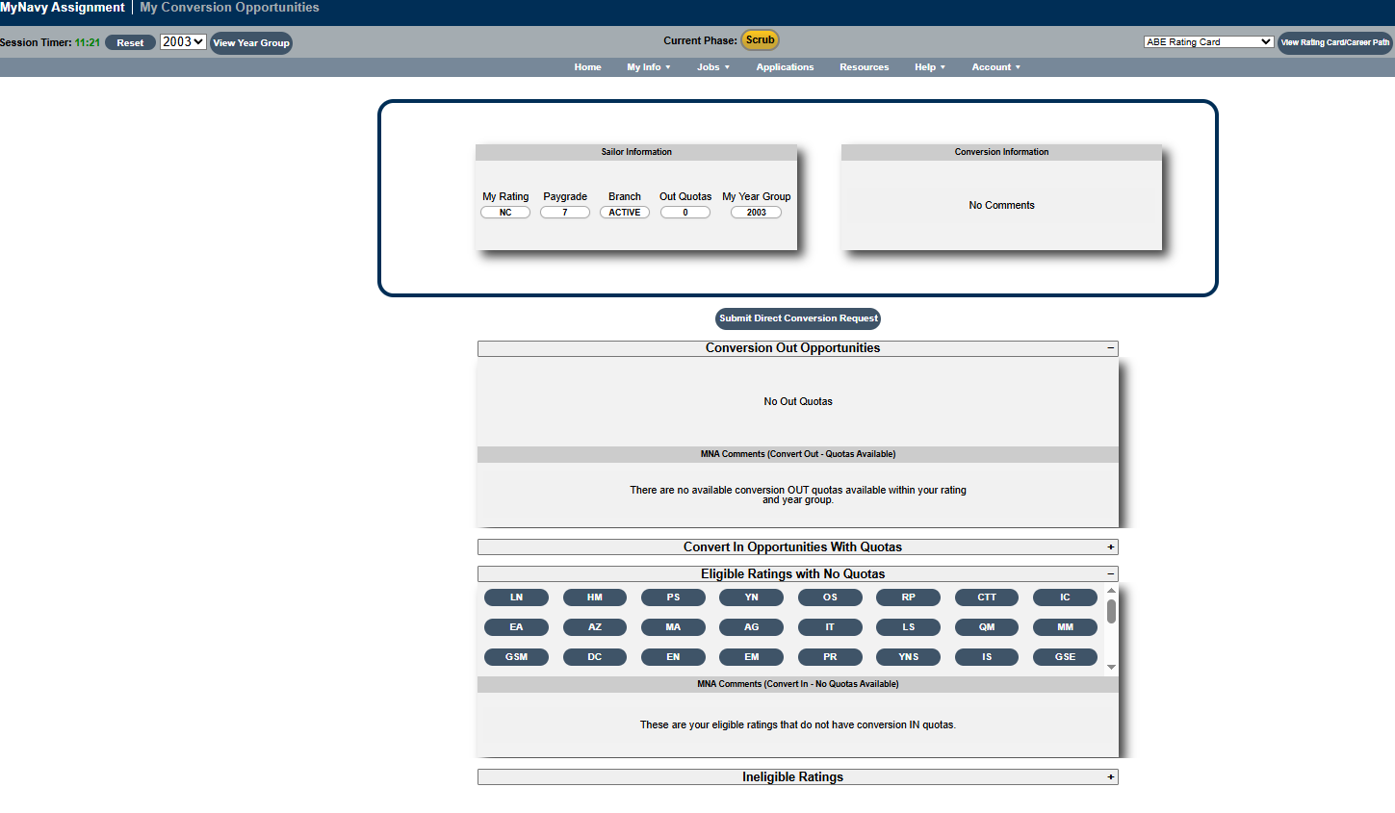
Enlisted Assignment System MNA Conversion Request
Rating opportunities and request are submitted in MNA
Member can request for rating conversion by clicking on “Submit Direct Conversion Request”
Command Career Counselors with Enlisted CCC MNA access can also submit OBLISERV request on behalf of Sailors
Note: Personnel must be “Qualified” in Career Waypoints to view rating conversion opportunities and submitted rating conversion request
Submit Direct Conversion Request
Convert In Opportunities with Quotas
Eligible Ratings with No Quotas
Notes:
FACILITATOR GUIDE:
Note: Personnel must be “Qualified” in Career Waypoints to view rating conversion opportunities and submitted rating conversion request.

Slide 29
Enlisted Assignment System MNA Special Programs/Pay
Requests for the following programs should be submitted prior to the member’s negotiation window:
Sea Duty Incentive Pay (SDIP)
POLICY DECISION MEMORANDUM (PDM) 001-21
Voluntary Sea Duty Program
MPM 1306-141
Overseas Tour Extension Incentive Program (OTEIP)
MPM 1300-310
Projected Rotation Date (PRD) adjustment
MPM 1306-900
Enlisted Assignment to Special Programs
MPM 1306-900
Notes:
*Slide added for function due to additional information being added.
FACILITATOR GUIDE:
SDIP - designed as an incentive for Sailors who volunteer to curtail their shore duty to return to sea early. Requires a NAVPERS 1306/7 request for the Voluntary Sea Duty Program (VSDP) MNM 1306-141 to be submitted per timelines below. Sailors can request SDIP-B – Back to Back/SDIP-C – Curtailment/SDIP-E - Extension **SEE NEXT SLIDE**
Voluntary Sea Duty Program
Sailors eligible to receive SDIP, per reference (b), are also eligible for VSDP and should request to receive SDIP in conjunction with VSDP.
Sailors on shore duty must submit their VSDP request through their chain of command no later than 12 months prior to their PRD to ensure receipt by NAVPERSCOM (PERS-40), using NAVPERS 1306/7.
Sailors currently on sea duty should submit requests for a back-to-back sea tour 9 to 12 months prior to their PRD.
OTEIP
Requests should be submitted not more than 18 months, but not less than 9 months, prior to current projected rotation date, for enlisted personnel requesting extensions beyond 12 months.
PRD adjustment
Detailers may issue orders directing transfer up to 6 months prior to PRD, and up to 6 months after the established PRD. Adjustments are case-by-case basis by the rating PPERS code.
Special Programs
Submit NAVPERS 1306/7 Enlisted Personnel Action Request to applicable detailer at Navy Personnel Command (NAVPERSCOM) approximately 12-15 months prior to member’s projected rotation date.

Slide 30
Enlisted Assignment System Sea Duty Incentive Pay (SDIP)
SDIP is designed as an incentive for Sailors who volunteer to curtail their shore duty to return to sea early
Requires a NAVPERS 1306/7 request for the Voluntary Sea Duty Program (VSDP) MNM 1306-141 to be submitted 14-16 months PRIOR to Projected Rotation Date (PRD)
Sailors can request
SDIP-B – Back-to-Back
SDIP-C - Curtailment
SDIP-E - Extension
SDIP eligibility chart is located on My Navy HR page
https://www.mynavyhr.navy.mil/References/Pay-Benefits/SDIP/
Notes:
FACILITATOR GUIDE:
SDIP eligibility chart is located on My Navy HR page. https://www.mynavyhr.navy.mil/References/Pay-Benefits/SDIP/
Timelines:
SDIP-B: voluntarily continue sea duty service beyond their PST by a minimum of 12 months and a maximum of 48 months. Requests must be received by the detailer 14 to 16 months prior to PST completion date/PRD.
SDIP-C: voluntarily curtail shore duty assignments by a minimum of six months prior to their original PRD to return to sea duty. Requests must be received by the detailer 6 to 9 months prior to the desired detachment date.
SDIP-E: voluntarily extend onboard their current command when assigned to a ship, submarine, aviation squadron, or battalion by a minimum of 12 months and a maximum of 48 months beyond their PST. Requests must be received by the detailer 14 to 16 months prior to PST completion date/PRD.

Slide 31
Enlisted Assignment System Assignment Incentive Pay (AIP)
Designed to attract qualified Sailors to certain jobs/billets that are hard to fill
AIP must be written in the orders
Sailors “bid” on an assignment through MNA – the “Best fit” Sailor gets the job
AIP jobs are identified in MNA with the AIP bid amount in a drop-down menu
Paid monthly and will be taxable income
Notes:
FACILITATOR GUIDE:
Purpose to distribute Servicemembers to historically difficult to fill billets determined by the Enlisted Distributed Division (PERS-40).
Current eligibility chart can be found on MyNavy HR<References<Pay-Benefits<AIP

Slide 32
Enlisted Assignment System Enlisted Personnel Action Request (NAVPERS 1306/7)
The NAVPERS 1306/7 was updated and automated to provide Sailors a standard Navy-wide format to submit requests to Assignment Control Authorities (ACAs)
Uploaded to MNP or email to MNCC at askmncc.fct@navy.mil for processing
Best Practices
Explain to the Sailor that it is like a special request chit, but the difference is that it is requesting action on behalf of the Sailor from PERS
Must be initiated by the Sailor so they understand the request they are making
Receive approved paper copy prior to electronic submission
When forwarding to MNCC via email indicate who the request should go to in the body of the email
Example: Forward to BUPERS 836
Notes:
FACILITATOR GUIDE:
The ePAR/1306/7 is submitted by the Sailor on MyNavy Portal (MNP), under Career Planning
The ePAR is electronically released by the CCC after it is endorsed by the CO/OIC
MyNavy Career Center (MNCC) receives the ePAR and routes to the proper ACA for disposition
When a disposition is made the Sailor and CCC will receive an email and the case status will also be updated on MNP
Hard copy requests can be scanned and submitted via email to askmncc.fct@navy.mil for those with low connectivity. Enter the PERS code in the subject line to ensure proper dissemination for processing.

Slide 33
Enlisted Assignment System Enlisted Personnel Action Request (NAVPERS 1306/7)
SAMPLE
SAMPLE
Notes:
FACILITATOR GUIDE:
Show an example of an Personnel Action Request

Slide 34
Enlisted Assignment System Assignment Programs
Overseas Screening
MILPERSMAN 1300-302
Military Couple Assignment
MILPERSMAN 1300-1000
Reassignment for Humanitarian Reasons (HUMS)
MILPERSMAN 1300-500
Exchanges of Duty (SWAPS)
MILPERSMAN 1306-700
Notes:
FACILITATOR GUIDE:
Example of assignment programs available.
Ensure to download applicable MPM articles and NAVADMINS for current eligibility and submission requirements.
Overseas Screening MILPERSMAN 1300-302:
Eligibility – CO has final authority
Must be interviewed to determine:
Medical and dental status
Drug and/or alcohol problems
Performance
Discipline issues
Sailor has 30 days to complete/ 60 days for dependents
Suitability/ unsuitability documented in BOL
Military Couple and Single Parent Assignment Policy, MILPERSMAN 1300-1000:
Not a guarantee
Both members must submit an endorsed ePAR/1306/7 to their detailer, only one request is required per career
Will not normally be on simultaneous sea duty unless volunteered
Sailors who apply for co-location must contact detailer directly, to apply for orders
Reassignment for Humanitarian Reasons (HUMS), MILPERSMAN 1300-500
Screening is most important element
Ensure to have supporting documents to support the request
Reason for reassignment must be resolvable within a reasonable period, normally within 6 to 12 months
Exchanges of Duty (SWAPS), MILPERSMAN 1306-700
Requirements:
Twelve months onboard at time of exchange of duty
Must not be in receipt of PCS orders
Must be same rate, rating, type duty classification code/NEC
Must have sufficient time remaining to provide 12 months at receiving command/ NUC 24
Must receive permission from both Cos
Sailors can search and post SWAPS listing on MNP
Career & Live Events/ Assignment, Leave, Travel/ SWAPS
Submit via ePAR to PERS-4, Enlisted detailer

Slide 35
Enlisted Assignment System Counselor Best Practices
Stay informed
Talk to your detailer about assignment options and opportunities
Discuss assignment options at Career Development Boards
Communication
Communicate with your CCC, chain of command, and detailers early (preferably 18-13 months prior to entering your orders negotiation window)
Update System Information
Update contact information, Resume and Preferences in MNA
Discuss Career Decisions with CCC
Have CPPA add update Career Decisions in Sales force for Full Navy Power FNP
Notes:
FACILITATOR GUIDE:

Slide 36
Knowledge Check
Why is it important to keep "My Resume" and "My Preferences" up to date in MNA?
What are two phases of MNA?
What are two programs that are a part of Billet Based Advancement?
What is the NAVPERS 1306/7 used for?
Notes:
FACILITATOR GUIDE:
To relay important information to the Detailer and future commands.
List two of the 7 phases listed in the PP
List two of the following:
CA2P
A2P
SEM
Requesting action on a career change; PRD adjustment, curtailing shore duty, special program requests, etc.

Slide 37
Summary and Review
In this lesson we discussed:
Enlisted Assignment System
Types of duty Assignments
Differences between Detailers and Placement
Assignment incentives
Billet Based Advancement (BBA)
OBLISERV request
Rating Conversion request
Common terms: PRD, TOS, and Obligated Service (OBLISERV)
Matching Service Member’s needs with their duty preferences
Enlisted Personnel Action Request (NAVPERS 1306/7)
Notes:
FACILITATOR GUIDE:

Slide 38
Questions?

